Slide 1
DATA WRANGLING
PROJECT-2
Notes:
SAMPLE PROJECT-2

Slide 2
Introduction -
Data wrangling is the Process of transforning raw data into a more processed shape by reorganizing cleansing and enriching it.
OR
Data wrangling is the process of removing errors and combining complex data set to make them more accessible and easier to analyze

Slide 3
Following are the examples of Data wrangling
Combining data source for analysis
Filling or receiving data gaps
Deleting unnecessary or irrelevant project data
Identifying data outliers and explaining or deleting them to allow analysis

Slide 4
Why is data wrangling importance
Raw business data come in a Verity of formats and locations so without data wrangling it’s difficult to compare thems also you can miss important insights it your data are incomplete, duplicate or wrong. By integrating and cleanythe data ,data wrangling gives you a full picture of your business and helps you make informed decisions.

Slide 5
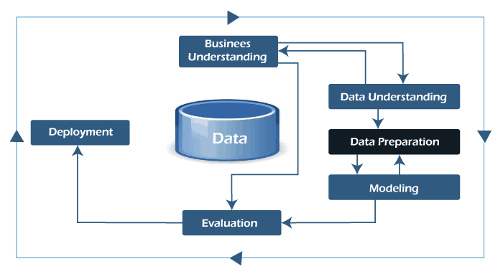
PROCESS OF DATA WRANGLING

Slide 6
Benefits of data wrangling
Data wrangling helps to improve data usability as it converts data in to a compatible format for the end system.
It helps to quickly build data flows within intuitive user interface and easily schedule and automate the data flow process.
Integrates various types of transformation and there source (like database,web services,files etc).
Help user to process very large volumes of data easily and easily share data flow techniques.

Slide 7
Data wrangling skills
To be able to performs series of data transformation like merging, ordering,aggregating.
To use data science programming languages like R, python,Julia,SQL on specific data sets
To make logical judgement based on underlying business context.

Slide 8
DATA WRANGLING IN PYTHON
Data wrangling is a critical topic for data science and data analysis, pandas framework of python in used for data wrangling.
Data wrangling in python deals with the below functionalities.
1.Data exploration:- in this process the data is studied,analyzed and understood by visualising representation of data.

Slide 9
2.Dealing with missing values: Most of the datasets having a vast amount of data contain missing values of NaN, they are needed to be taken care of by replacing them with mean,mode, the most frequent value of the column, or simply by dropping the row having a NaN value.
3.Reshaping data: In this process, data is manipulated according to the requirements, wherenew data can be added or pre-existing data can be modified.

Slide 10
4.Filtering data: Some times datasets are comprised of unwanted rows or columns which arerequired to be removed or filtered
5.0ther: After dealing with the raw dataset with the above functionalities we get an efficient dataset as per our requirements and then it can be used for a required purpose like data analyzing, machine learning, data visualization, model training etc.

Slide 11
CONCLUSION
Data wrangling can help in reducing the burden of the data analysis process.

Slide 12
Thank You

